Slide 1
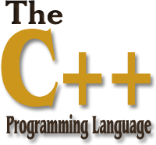
01
02
Lecture 12
04

Slide 2

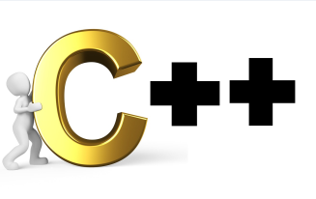
Today’s Agenda
01
What Is Default Function Argument?
01
02
Restriction On Default Function Arguments
03
Restriction On Default function Arg. Call
04
05
Default Parameterized Constructor

Slide 3

What Is Default Function Argument?
.
Default Function Argument is a technique using which a programmer can
call a single function in multiple different ways.
In Other words, DFA allows us to write a single function definition and call
the same function with multiple different number of arguments.
For a programmer DFA is an alternative to function overloading. That just
like function overloading DFA also allows us to call the function in different
ways, but in case of function overloading we define multiple functions and
then we can call them differently.

Slide 4
What Is Default Function Argument?
.
But in case of DFA we define just one function, and that same function can
be called in different ways.
So DFA is much simpler than function overloading.
Example:
void printline(char=“*”,int=5);
int main()
{ printline(“A”,10);
printline(’#’);
printline();
return 0; }
printline(‘A’,10);
printline(‘#’,5);
printline(‘*’,5);

Slide 5
Restriction On DFA
.
Although DFA is powerful technique but it has one major restriction.
The restriction is that, the default arguments declared in function prototype
must always be the Trailing Arguments.
In other words we can say that if an argument in a function has been
declared as default argument than all the arguments after it must also be
declared as default argument or it should be the last argument in function
declaration.

Slide 6
Restriction On DFA
.
Examples:
void show(int,int,int=30); // OK
void show(int=10,int,int=30); // ERROR
void show(int,int=20,int=30); // OK
void show(int=10,int=20,int=30); // OK
void show(int,int=20,int); // ERROR

Slide 7
Restriction On DFA Call
.
While calling a function which has default arguments set, if we skip a particular
argument, than all the arguments after it must also be skipped.
Example:
void display(int=10,int=20,int=20);

Slide 8
Restriction On DFA Call
.
Which of the following calls are valid?
display(); // OK
display(15); //OK
display(, 25, 35); //ERROR
display(10,25,35); //OK
Display(10,20,30);
Display(15,20,30);

Slide 9
Default Parameterized Constructor
.
We can avoid Constructor Overloading using Default Parameterized
Constructor:
#include<iostream.h>
#include<conio.h>
Class Student
{
int roll;
char grade;
float per;
Public:
Student(int=0,char=‘ ‘,float=0.0);
void get();
void show();
};
Student : : Student(int r, char g, float p)
{
roll=r;
grade=g;
per=p;
}

Slide 10
Default Parameterized Constructor
.
void Student : : get()
{
cout<<“Enter roll, grade and per:”;
cin>>roll>>grade>>per;
}
void student: : show()
{
cout<<roll<<“,”<<grade”,”<<per<<endl;
}
Int main()
{
Student S(10, ‘A’, 87.3);
Student P;
P.get();
S.show();
P.show();
getch();
return 0;
}

Slide 11
Default Parameterized Constructor
.
Output :
Enter roll, grade and per:18 B 56
10 A 87.3
18 B 56

Slide 12
End of Lecture 12
For any queries mail us @: scalive4u@gmail.com
Call us @ : 0755-4271659, 7879165533
Thank you

